Slide 1
Social Media Analysis Project
By Reena Jagdev Kamat

Slide 2
Problem Statement
You are hired as a data analyst at Meta and asked to collaborate with the Marketing team. Marketing teams want to leverage Instagram's user data to develop targeted marketing strategies that will increase user engagement, retention, and acquisition. Provide insights and recommendations to address the following objectives.

Slide 3
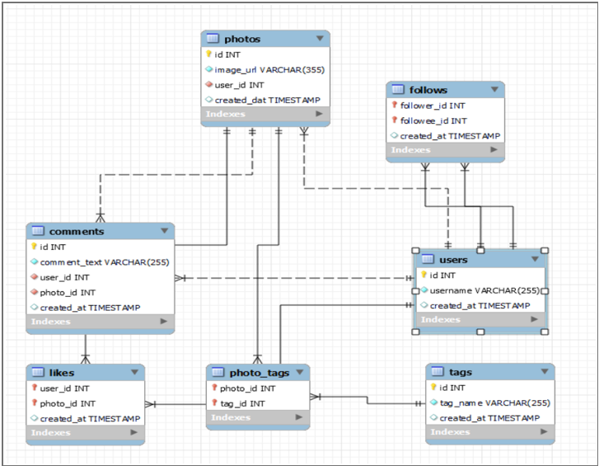
Database Schema

Slide 4
Project Overview
Data Quality
User Activity
Engagement
Checked core tables for missing values, duplicates, and logical inconsistencies.
Compared posting, liking, and commenting behaviour across users.
Measured likes and comments to identify high-performing creators.
Network Growth
Content Insights
Reviewed follower and following counts to surface connected accounts.
Analyzed tags and hashtags to understand what resonates with users.

Slide 5
1. Data Quality Checks
Reviewed the users, photos, comments, likes, and follows tables.
Checked critical fields for NULL or blank values.
Grouped key fields and used HAVING COUNT(*) > 1 to detect duplicates.
The project notes report no detected duplicates or missing values in the checks performed.
Why it matters: reliable data improves the accuracy of downstream analysis.

Slide 6
2.Distribution of User Activity Levels
Highly Active Posters
Balanced Engagers
Eveline95, Clint27, and Cesar93 publish about 10–12 posts, but have no likes or comments in the described result.
Kathryn80, Josianne.Friesen, Adelle96, and Janet.Armstrong post around 5 times and show high likes and comments.
Low Posters, High Interaction
Inactive Users
Aniya_Hackett, Mike.Auer39, Mckenna17, and Nia_Haag have 0 posts but 257 likes and comments combined, as stated in the supplied summary.
Kasandra_Homenick and Bartholome.Bernhard show 0 posts, likes, and comments in the described segment.

Slide 7
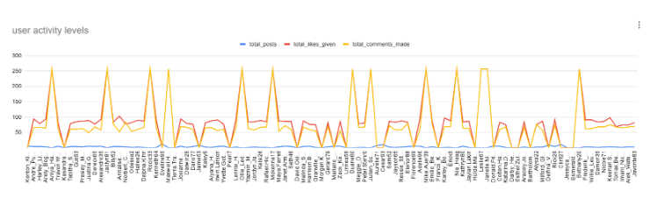
User activity level
the "user activity levels" graph illustrates the distribution of individual user engagement across three core metrics: total posts, total likes given, and total comments made. While the line for total posts (blue) remains consistently low and near the baseline across the user base, both total likes given (red) and total comments made (yellow) exhibit significant fluctuations. Several prominent spikes reveal highly active users who contribute substantially higher volumes of comments and likes, whereas other intervals dip sharply toward zero, highlighting segments of inactive or low-engagement users

Slide 8
3. Engagement Analysis
Top Contributors
Engagement Rate
How to Use It
Eveline95: 341
Cesar93: 318
Clint27: 310
Reported engagement scores.
Combined likes and comments are divided by posts uploaded to compare interaction per post.
Study high-performing users’ themes, captions, and posting schedules; support mid-tier creators with campaigns.

Slide 9
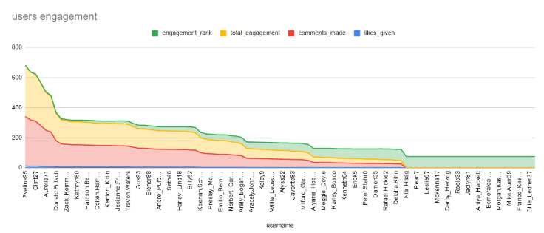
User engagement
The chart shows that user engagement is concentrated among a few highly active users, with Eveline95 ranking highest in total engagement, followed by Clint27 and Cesar93. As the ranking progresses, total engagement, comments, and likes generally decline, indicating a significant difference in interaction levels across users. Comments and likes contribute to the overall engagement scores, while several users at the lower end show very little activity. These insights can help identify top-performing users for recognition and influencer marketing, while targeted campaigns can encourage less-active users to participate more.

Slide 10
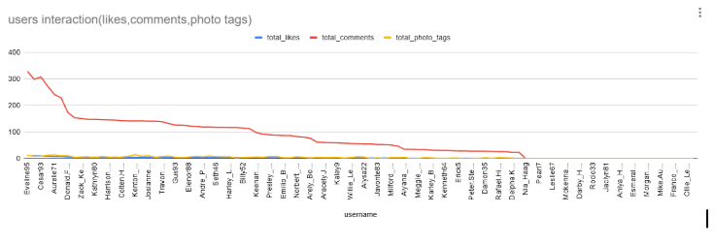
User interactions
The chart shows the distribution of user interactions, including likes, comments, and photo tags, across different users. A small number of users generate significantly higher engagement, while the interaction levels decline steadily for the remaining users. Comments appear to be the dominant form of interaction, whereas likes and photo tags contribute comparatively less. This indicates that user engagement is unevenly distributed, with a few highly active users contributing a substantial share of the overall interactions.

Slide 11
4. Content Tags & Hashtag Insights
Average Tags per Post
Highest Average Likes
Highest Total Likes
Calculated as total photo tags divided by total photos. The source material does not provide the numeric result.
Dreamy leads at 35.75 average likes per photo across 20 photos, according to the report.
Beach records 1,448 total likes across 42 photos in the reported results.

Slide 12
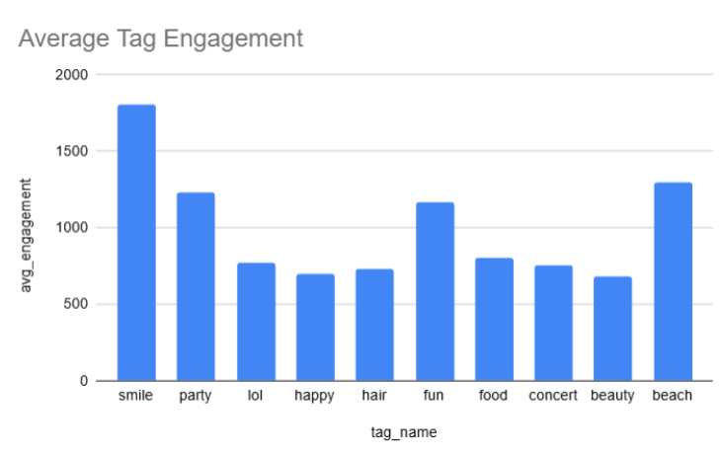
Tag engagements
Based on the chart we can conclude that smile leads all tags with the highest average tag engagement of approximately 1,800, followed by beach (around 1,300) and party (around 1,230). Other tags like fun and food show moderate engagement, while categories such as happy, hair, and beauty record the lowest average engagement, hovering around 700

Slide 13
5. Network Growth & Influencer Discovery
Follower Count
Following Count
Campaign Selection
Identifies accounts with larger audiences and potential reach.
Shows users who actively connect with other accounts.
Combine follower counts with engagement metrics to find creators who have both reach and audience interaction.

Slide 14
6. Inactive Users & Audience Segmentation
Inactive Segment
Re-engagement
Segment-Based Offers
The project identifies users with no posts and no likes; examples include Kasandra_Homenick, Tierra.Trantow, and Pearl7.
Try personalized notifications, trending-topic prompts, contests, activity streaks, and milestone badges.
Reward highly active contributors, nurture moderate users, and offer low-activity users simple ways to participate.

Slide 15
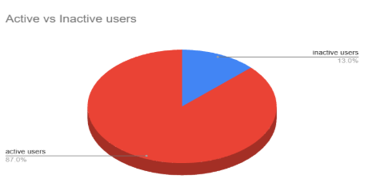
Active vs inactive users
Based on the provided social media data, the pie chart illustrates the distribution of users across the platform, showing that active users make up the vast majority at 87.0%, while inactive users account for 13.0%.

Slide 16
User Segmentation for Targeted Marketing
Active creators
High-engagement creators
Many posts; engagement may be low
Next action: Offer creator tips, feedback, and distribution tests.
Fewer posts, strong likes/comments
Next action: Recommend creator tools and spotlight opportunities.
Interactive consumers
Inactive users
Few/no posts but many likes/comments
Next action: Recommend relevant creators, communities, and content.
No posts and no likes recorded
Next action: Use onboarding, discovery prompts, and low-friction challenges.

Slide 17
Recommendations
Recognize top contributors with badges, leaderboards, and early access to features.
Use high-performing tags and themes to personalize recommendations and ad creative.
Partner with creators who combine audience reach with strong engagement.
Re-engage inactive users through low-friction prompts, challenges, and tailored notifications.
Test posting schedules and content formats; measure performance before scaling.
Track total engagement alongside engagement per post for a balanced view of performance.

Slide 18
Re-engagement Plan
RECOMMENDED CAMPAIGN IDEAS
1. IDENTIFY
2. ENCOURAGE
3. ACTIVATE
4. MEASURE
No posts + no likes
Personalized campaigns
First post or first like
Track return activity
Personalized reminders
Content recommendations
Community challenges
Invite users to try a first action.
Show topics and hashtags that fit interests.
Make joining in feel easy and social.
Gamification & rewards
Exclusive benefits
Feedback collection
Offer beginner badges or small milestones.
Give returning users a reason to explore.
Ask what would improve their experience.

Slide 19
Conclusion
- Instagram user data highlights key trends in engagement, posting patterns, and content preferences.
- These insights can help Meta:
Increase engagement by optimizing posting schedules and hashtag strategies.
Strengthen user retention through personalized experiences and targeted re-engagement campaigns.
Expand user acquisition by partnering with influencers and reaching niche audiences.
- Overall, a data-driven marketing strategy enables Meta to create more effective, cost-efficient campaigns that align with user interests and behavior.

Slide 20


